Slide 1
Unit 3
Infrastructure Architecture and Design

Slide 2
Infrastructure Architecture
Every application needs an infrastructure to be deployed
These infrastructure includes middleware components, hardware and software, networking and communication protocols

Slide 3
Infrastructure Architecture (contd..)
Infrastructure Architecture Building Blocks
Infrastructure Architecture is composed of main 4 building blocks
1. Networking, internetworking and communication protocols
2. IT Hardware and software
3. Middleware
4. Policies for infrastructure management

Slide 4
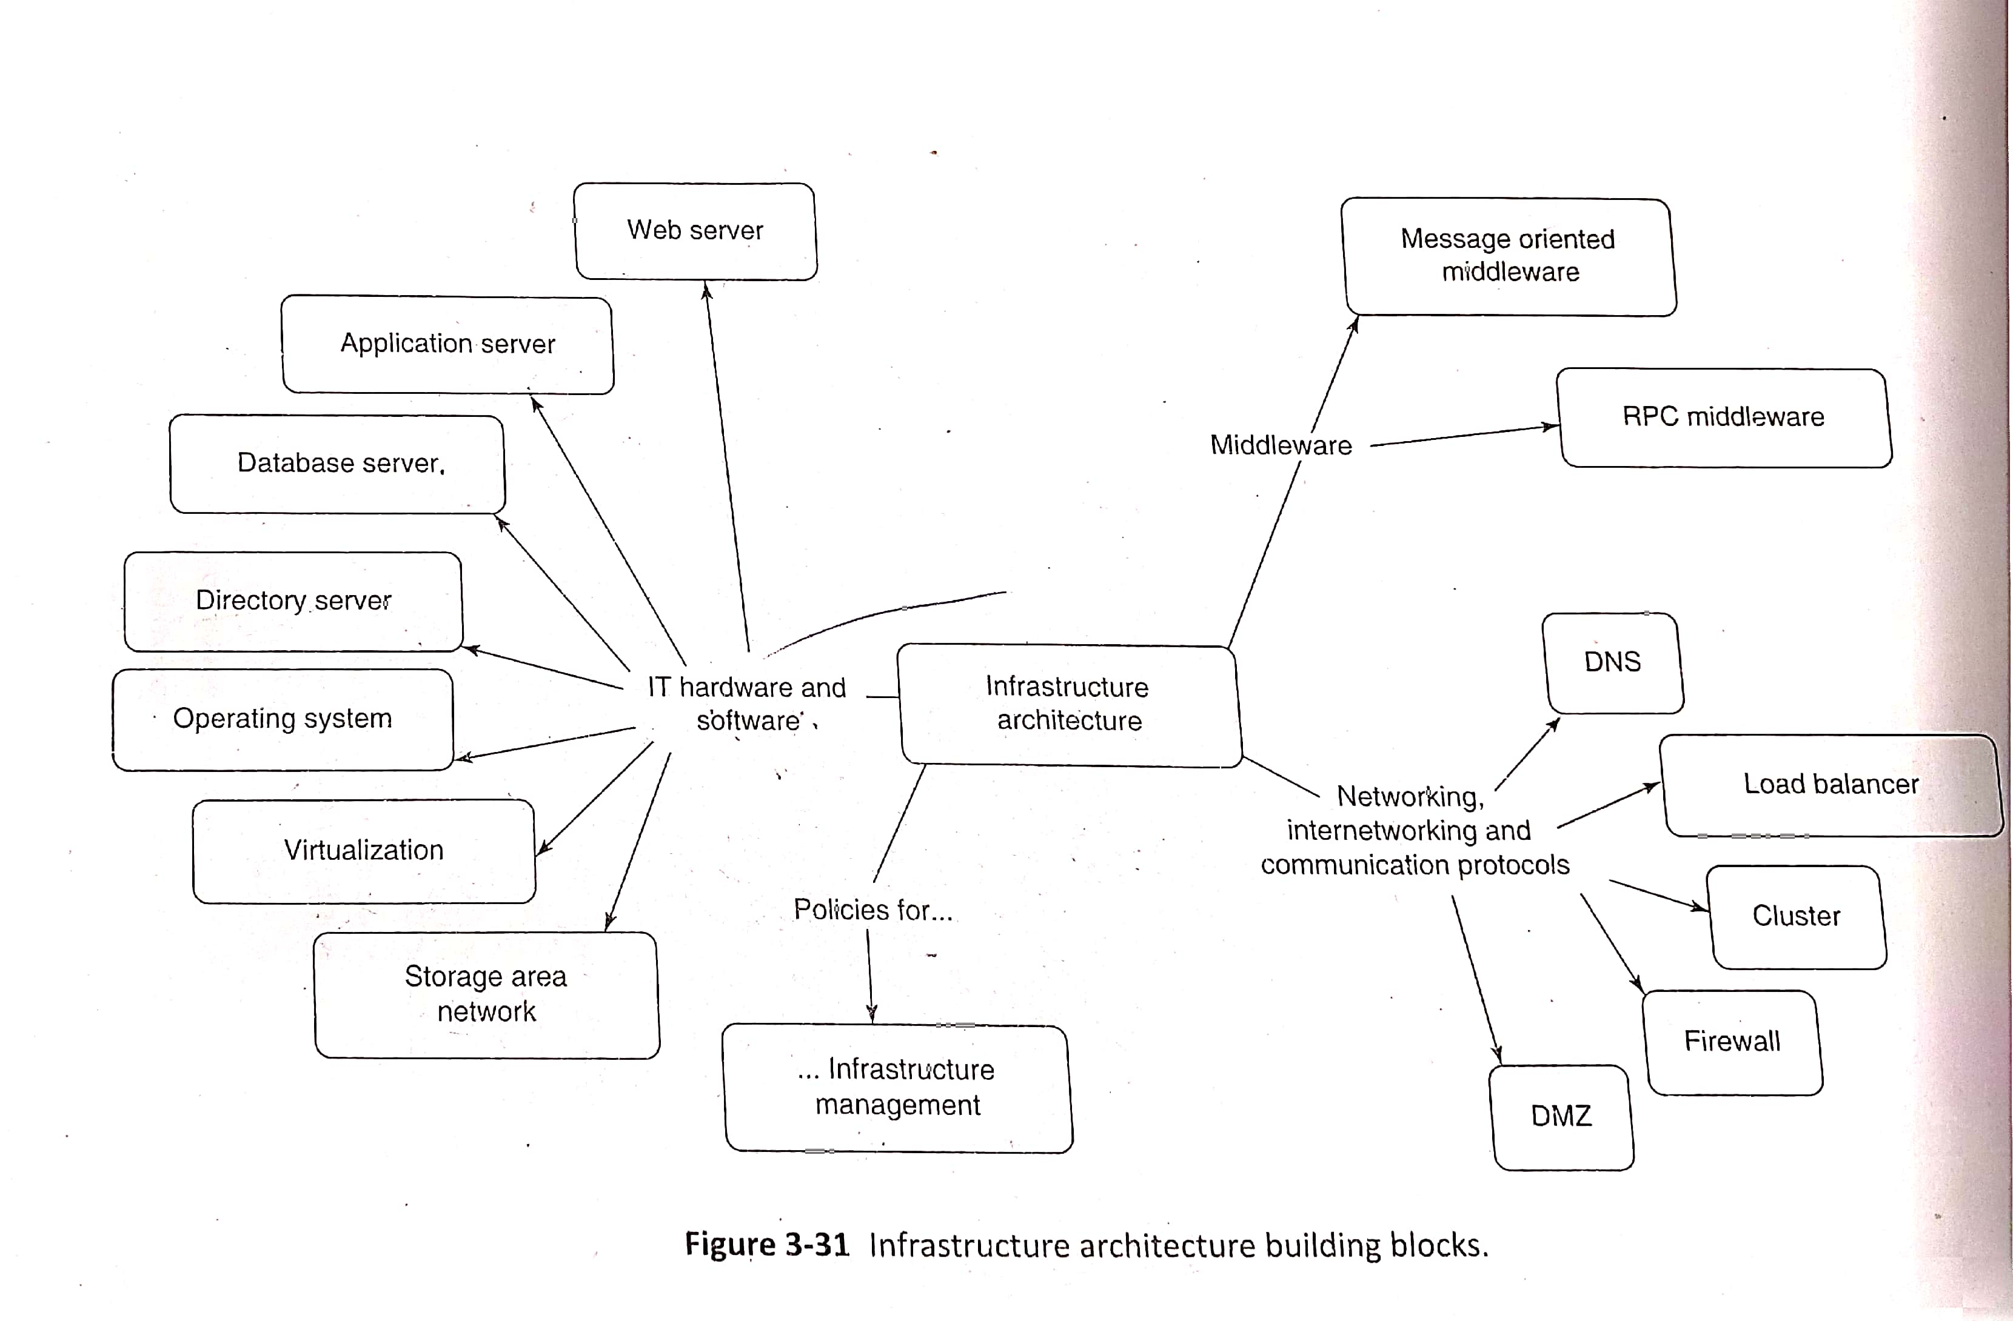
Infrastructure Architecture (contd..)
Below diagram shows the infrastructure architecture building blocks

Slide 5
Infrastructure Architecture (contd..)
Networking, internetworking and communication protocols
An enterprise have its operations being carried out at multiple locations. Each location may have multiple servers hosting different parts of an enterprise application
Connectivity between these locations are supported by networking, internetworking and communication protocols
Following are the key elements in this networking building block,
i). DNS (Domain Name Server)
ii) Load Balancer
iii) Cluster
iv) Firewall
v) Demilitarized Zone (DMZ)

Slide 6
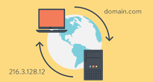
Infrastructure Architecture (contd..)
i). DNS (Domain Name Server)
Every server needs an unique identity to identify it in the network
That unique identity is provided by the Internet Protocol (IP)
Every enterprise application is accessed via an Uniform Resource Locator (URL)
This URL is mapped to a specific IP address with the help of DNS

Slide 7
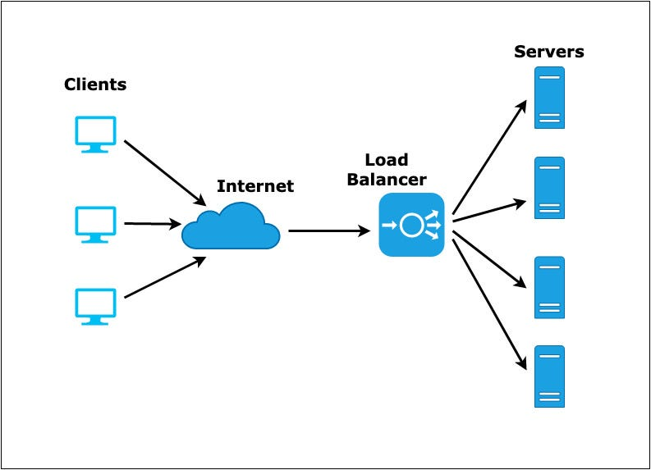
Infrastructure Architecture (contd..)
ii) Load Balancer
A Loan Balancer is used to split the traffic and diverting the requests to multiple identical servers.
The URL given by the user is mapped to the Load Balancer instead of the actual server which helps in diverting the request
With the help of Load Balancer all request will not be directed to the same server itself
Load Balancer is available in both hardware and software
It is used to ensure scalability of the application

Slide 8
Infrastructure Architecture (contd..)
iii). Cluster
It is collection of servers that appear to be a single virtual server to the user
An application is hosted on each of these servers and server can process a request
In the deployment of enterprise application, load balancer and cluster both are used to achieve scalability
iv). Firewall
Security of the application is an important one
Firewalls are used for network security
Firewalls are used by the application to protect their resources against unauthorized access in the internet
Firewalls are configured to allow HTTP/HTTPs request to pass through them
Cisco Pix (is a hardware firewall) and Checkpoint (is a software firewall) are popular firewalls

Slide 9
Infrastructure Architecture (contd..)
v). DMZ
Demilitarized Zone (DMZ) also known as perimeter network is a sub network of an organization that provide access to the external facing services of an enterprise to the outside world
Typically DNS, Load Balancer and Web servers are kept in DMZ. Application servers and database servers are kept behind DMZ
The area between external firewall and internal firewall is called as Demilitarized Zone
Refer the diagram in next slide

Slide 10
Infrastructure Architecture (contd..)
Example
In the below diagram load balancer and Web servers are placed in the DMZ and Application servers and Database servers are kept behind DMZ
External Firewall
DMZ
Internal Firewall

Slide 11
Infrastructure Architecture (contd..)
2. IT Hardware and Software
IT Hardware and Software is the core building block of the infrastructure architecture which consists of the following elements:
i). Operating System
ii). Database server
iii). Web server
iv). Application server
v). Directory server
vi).Virtualization
vii). Storage Area Network

Slide 12
Infrastructure Architecture (contd..)
2. IT Hardware and Software
i). Operating System
Every servers are hosted in an operating system
Operating system provides a complete set of facilities to manage the hardware and software resources of these servers
Activities like monitoring running applications, starting or stopping the servers, managing configuration files are done by the operating systems
ii). Database server
Database server provides data related services
These services include storage, search, retrieval of data from database
It should also provides integrity, security and transaction support
Relational databases are the most used form of database management systems
Oracle, Microsoft SQL server, My SQL are popular database servers

Slide 13
Infrastructure Architecture (contd..)
2. IT Hardware and Software
iii) Web Server
The server that accepts HTTP request from a browser and give response to them is called Web server
It is typically the entry point to the enterprise application
It provides services like load balancing, scalability, reliability
Apache Web Servers and Microsoft Internet Information Server (IIS) are popular web servers
iv) Application server
The core business logic of an application is implemented on an application server
The application server provides various system-level services
These services include transaction management, concurrency management, resource monitoring, application security, load balancing
Oracle Weblogic server, IBM Websphere application server, Sun Java System Application server are examples application server products

Slide 14
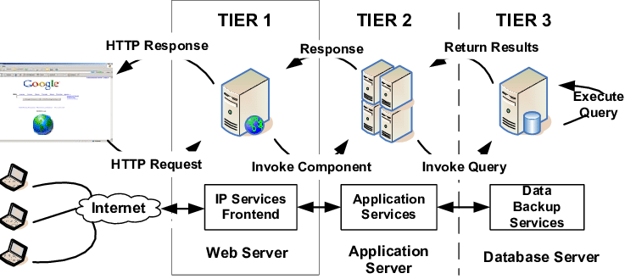
Infrastructure Architecture (contd..)
2. IT Hardware and Software
Web Server vs Application server vs Database server

Slide 15
Infrastructure Architecture (contd..)
2. IT Hardware and Software
v) Directory Server
Directory server is a kind of data store
This type of server stored data that are required by various enterprise applications
vi) Virtualization
Virtualization uses software that simulates hardware functionality to create a virtual system
Virtualization is a mechanism to abstract IT infrastructure
This practice allows IT organizations to operate multiple operating systems, more than one virtual system and various applications on a single server
Many organizations use virtualized environment for development and testing
Vmware and Virtual Box are popular Virtualization softwares

Slide 16
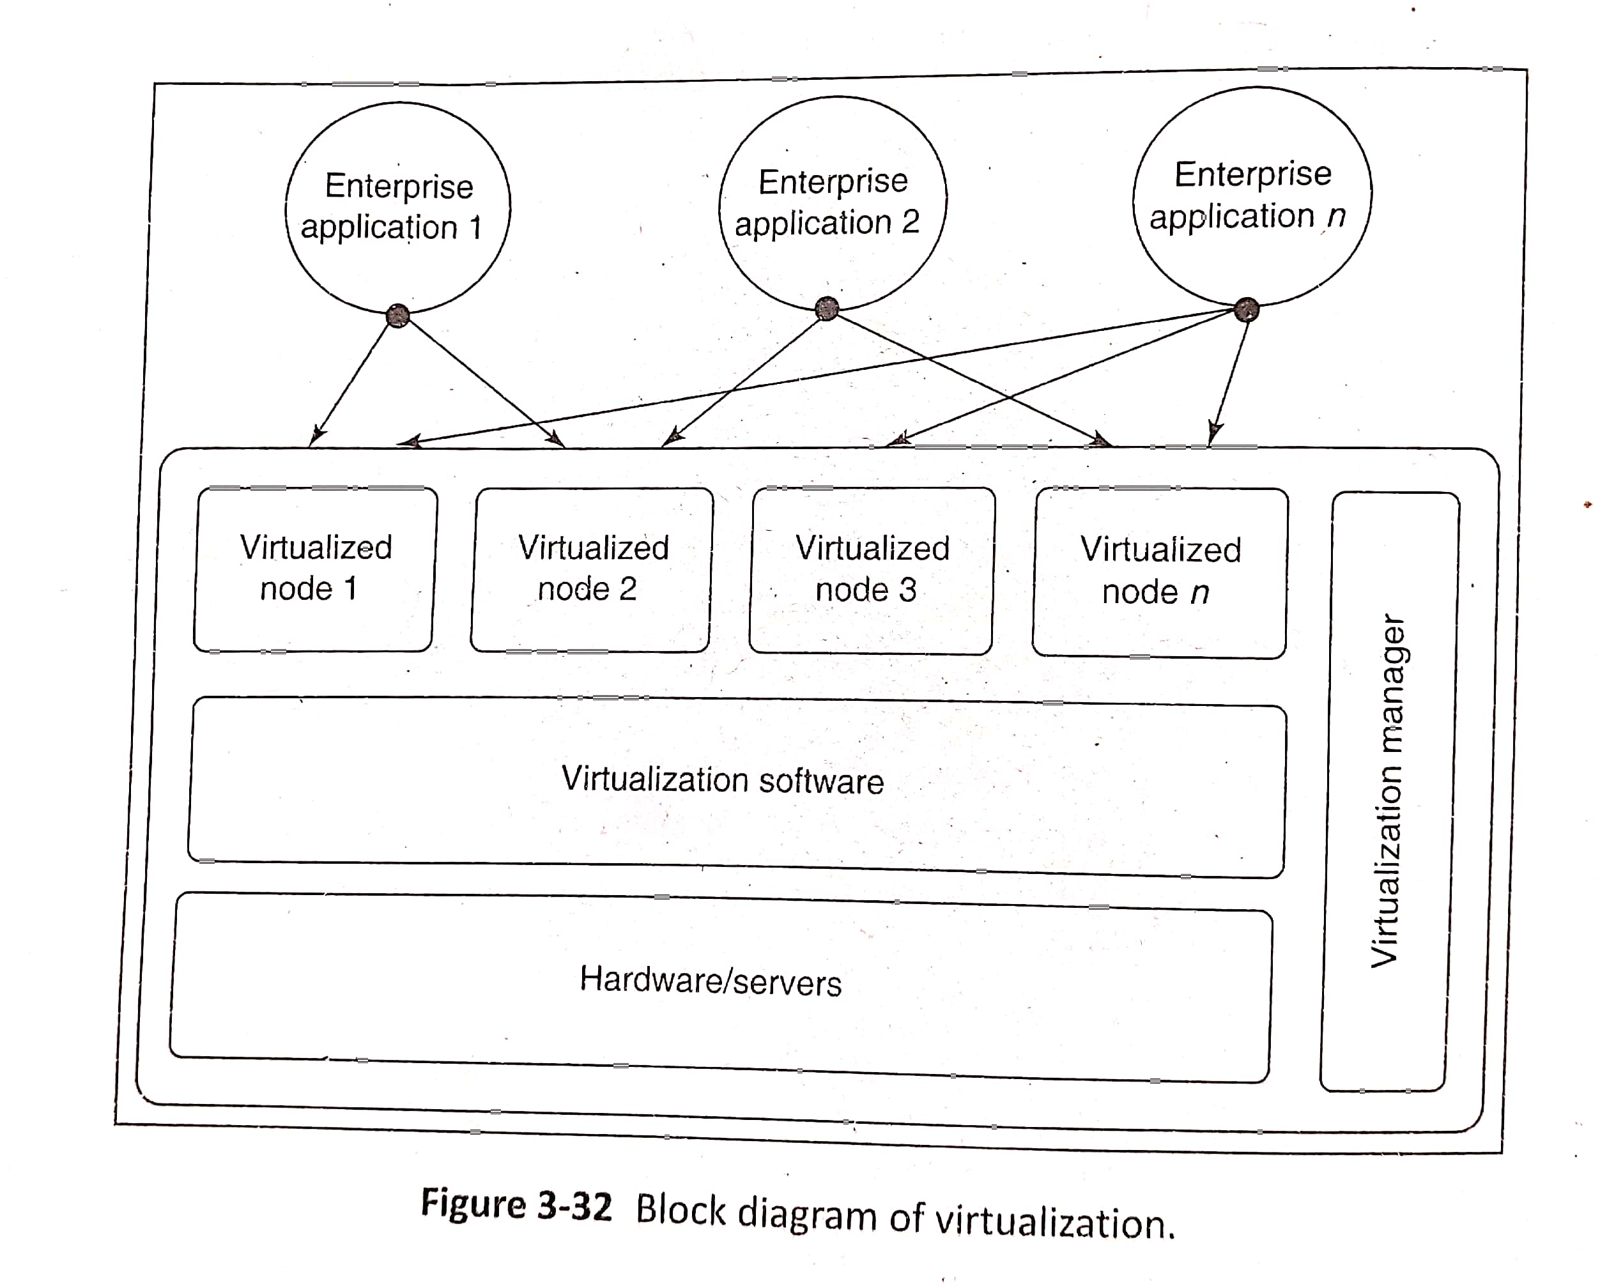
Infrastructure Architecture (contd..)
2. IT Hardware and Software
vi) Virtualization

Slide 17
Infrastructure Architecture (contd..)
2. IT Hardware and Software
vii) Storage Area Network (SAN)
Some servers are added with storage devices of large capacity and shared across applications.
These appear as local storage and this type of configuration is called as Storage Area Network(SAN)

Slide 18
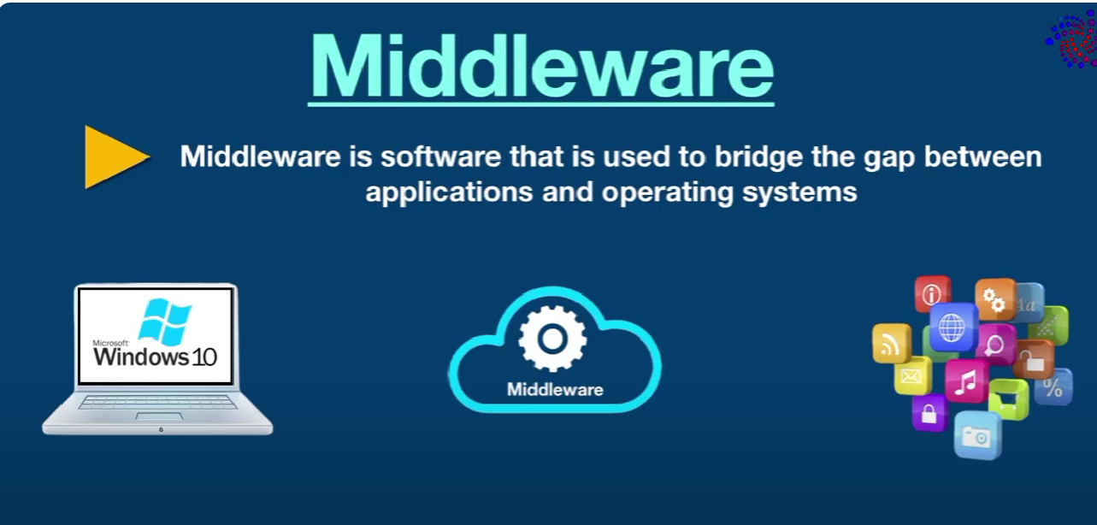
Infrastructure Architecture (contd..)
3. Middleware
Middleware is software that lies between an operating system and the applications running on it.
Middleware is the software glue that binds together the software pieces of a distributed application and enables integration of discrete enterprise applications and their components
It is used for interoperability and enhance reliability of applications

Slide 19
Infrastructure Architecture (contd..)
3. Middleware
Middleware can be categorized into the following types:
Message Oriented Middleware (MOM):
MOM is based on a client/server architecture and is used for reliable transport of messages across heterogeneous, geographically distributed systems.
It provides additional services like message translation and transformation, routing messages to the destination
Remote Procedure Call (RPC):
RPC is also a client/server architecture that provides a mechanism for invocation of procedures on a remote server in a way identical to invocation of local procedures, by completely hiding the details of the underlying network
It is a protocol that one program can use to request a service from a program located in another computer on a network

Slide 20
Infrastructure Architecture (contd..)
4. Policies for Infrastructure Management
Infrastructure of an organization is governed by some policies
These policies are organized as Control Objectives for Information and related Technology(COBIT) and Information Technology Infrastructure Library (ITIL)
COBIT provides an IT governance framework and toolsets. ITIL is a set of policies and best practices to manage IT infrastructure, development and operations
Data Governance Policy is used for defining procedures, guidelines, management of data

Slide 21
Infrastructure Architecture (contd..)
Deployment Strategy
In deployment strategy decisions like number of servers needed to deploy the application, how to define security perimeter, firewalls, where to application configuration data and many more are defined
Below diagram shows the deployment strategy used for the LoMS application

Slide 22
Infrastructure Architecture (contd..)
Deployment Strategy
For the Deployment of LoMS (refer diagram in previous slide) it is decided to have two Firewalls. One is external firewall and one is internal firewall. External Firewall is Cisco Pix and Internal Firewall is Nokia/Checkpoint
Load balancer and Web servers are used in between external and internal firewalls. This zone is called as Demilitarized Zone(DMZ)
Load Balancer is used to split and give the loads to the Web server
Behind internal firewall we are having application servers and Database servers

Slide 23
Architecture and Design Documentation
Architecture and Design Documentation is needed to record the results of architecture and design phase
This documentation is used in the construction phase

Slide 24
Architecture and Design Documentation (contd..)
System Architecture Documentation
The architecture of an enterprise application is documented in the System Architecture Documentation (SAD)
It is also called as high-level design and act as blueprint for detailed design process
Some of the key elements in SAD are shown in next slide

Slide 25
Architecture and Design Documentation (contd..)
System Architecture Documentation
SAD Element | Description
Goals of the architecture | Include standard principles of architecture that needs to be followed
Solution constraints | Constraints to be met in the architecture
Logical Architecture | Logical representation of all layers
Quality of services | Captures qualities a good software should posses and Non-Functional Requirements
Interface/ integration requirements | Information about external systems
Technology selection | Tools, technologies, frameworks
Technical architecture | Technical solution
Data architecture | Business entities and relationships. Includes data storage, data security and data integrity
Infrastructure architecture | h/w, s/w, middleware, network topologies

Slide 26
Architecture and Design Documentation (contd..)
Design Documentation
The detailed design of an enterprise application can be documented in several ways - technical layer wise, module/use case wise, component wise, or typically a mix of them
Design documentation is used for effective communication among application teams
Design documentation should include use case, presentation, business and data access layer components. Also integration and data layer can be designed
Below table shows the key elements of presentation layer design document
SAD Element | Description
Screen mockups | Wireframes, UI layout, screen templates and event handling
Error handling | Recovery actions in the event of errors and messages to be dispalyed
Input validation | Rules for validating user input data on both client and server side

Slide 27
Architecture and Design Documentation (contd..)
Design Documentation
Below table shows the key elements of business and data access layer design document
SAD Element | Description
Business delegate | Captures set of methods that need to be invoked for a specific business service
Session facade | Captures the list of services that need to be grouped under a facade
Business service | This captures the business interfaces and their implementation details
Business Model | This captures the business entities and their interrelationships
Data Access Layer components | This includes the design details of data access components, object relational mappings etc.

